Slide 1
Getting Started with .NET core 2.0

Slide 2


Presented by
Chilezie Unachukwu (@iamchilas)
Michael Ikechi
(@mykeels)

Slide 3
What's new?
New Project Templates
It's faster to get started
Razor Pages
Two-factor Authentication (with Authentication Apps)
Page and View Compilation
Performance (much faster)

Slide 4
New Project Templates
Execute "dotnet new –help" in command-line
Angular
React
React and Redux
Razor
Web API
MVC
Notes:
Create a new razor project template

Slide 5
It's faster to get started
Nuget packages restored automatically within dotnet new
Nuget restore is almost instantaneous
One package to rule them all (Microsoft.AspNetCore.All)
WebHost.CreateDefaultBuilder

Slide 6
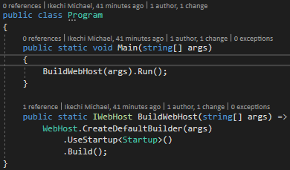
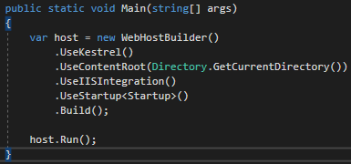
Program.cs
aspnetcore 2.0
aspnetcore 1.1

Slide 7
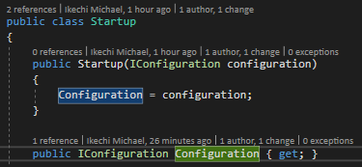
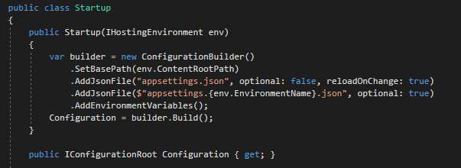
Startup.cs
aspnetcore 2.0
aspnetcore 1.1

Slide 8
Razor Pages
Design views with a Page Model
Encourages Rapid Application Development

Slide 9
Two-factor Authentication (with apps)
Integrate 2FA using popular authentications like authy

Slide 10
Performance is much faster
Page and View Compilation

Slide 11
THANK YOU

